Slide 1
Depathologising the university
https://www.sheffield.ac.uk/ihuman/waarc

Slide 2
Acknowledge support of …
Humanising Healthcare
Economic and Social Research Council
Humanising the Healthcare of People with Learning Disabilities and/or Autism funded by the Economic and Social Research Council (ES/W003406/1)
Disability Matters
Wellcome Discretionary Award
https://www.sheffield.ac.uk/ihuman/disability-matters
Wellcome Anti-ableist Research Culture
A Wellcome Trust Institutional Funding for Research Culture Award
https://www.sheffield.ac.uk/ihuman/wellcome-anti-ableist-research-culture-waarc

Slide 3
Aims of the session
Introduce WAARC
Explore this as a potentially depathologising project
Sit with depathologisation alongside decolonisation
Give some examples of how we are trying to meet these aspirations - specific reference to recruiting research associates and a project manager
We will read from the slides for access and describe any images

Slide 4
Guiding research question …
What might it mean if disability was the driving subject of our thinking about the university?

Slide 5
Key sources
Goodley, D. (2024) Depathologising the university, Pedagogy, Culture & Society, DOI: 10.1080/14681366.2024.2316007
Lewis-Wilson S, Towers S and Wykeham H. (2023). The Luck of the Draw: Wellcome’s Institutional Fund for Research Culture [version 2; peer review: 1 approved with reservations]. Wellcome Open Res 2023, 8:525.
Wellcome Anti-ableist Research Culture A Wellcome Trust Institutional Funding for Research Culture Award https://www.sheffield.ac.uk/ihuman/wellcome-anti-ableist-research-culture-waarc

Slide 6
And …
la paperson. (2017). A third university is possible. Minneapolis, MN: University of Minnesota Press.
Within the colonizing university also exists a decolonising education. Occupying the same space and time are the coloniser’s territories and institutions and colonised tim but also indigenous land and life before and beyond occupation (xiii)

Slide 7
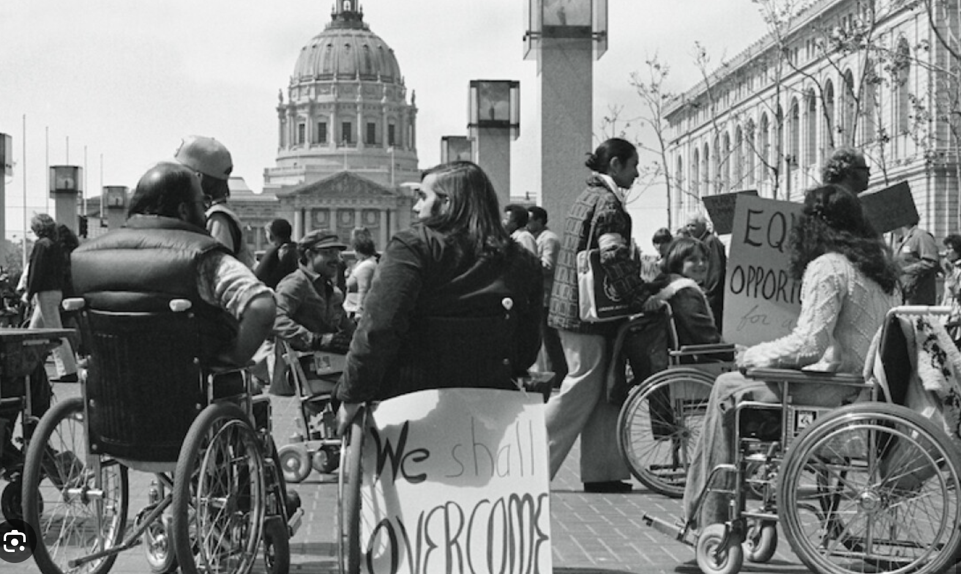

Slide 8
A Depathologising University

Slide 9
Some ideas to experiment with …
When disability rocks up in the university it does things - it disrupts, challenges, creates frictions and possibilities
We might like to think of the things disability does as depathologising the university
Depathologisation learns from decolonisation and vice versa
The depathologising university might already be happening
Universities already have within them the seeds of their own demise (or at least of their own depathologisation)
Disability cannot help but produce in excess of itself (cheers to Foucault and Wynter)
Disability creates lines of flight and experimentation (thank you Deleuze and Braidotti)

Slide 10
WAARC: Wellcome Anti-Ableist Research Culture
https://www.sheffield.ac.uk/ihuman/wellcome-anti-ableist-research-culture-waarc

Slide 11
We are one of 24 institutions funded by the Wellcome Trust to research, develop and enhance research culture within their universities (see Lewis-Wilson et al, 2023). £1 million project brings together disabled and non-disabled academics at the University of Sheffield - working in consultation with disabled people's organisations - to find and promote anti-ableist practices in TUOS.
Environment will experiment with new ideas for inclusive recruitment and employment.
Development will produce new guidelines on accessible research events and deliver a new course on inclusive research methods to raise capacities of PGRs and ECRs.
Collaboration will put disabled people front and centre and in collaboration will offer funding, via an open call, to other researchers and professional services colleagues to produce their own inclusive research projects and we will revisit the Concordat on Researcher Development to ensure inclusivity.

Slide 12
Briefly reflect on Environment: inclusive recruitment practices
To recruit 4 Research Associates and members of staff
Space to think about inclusive recruitment, explore our understanding and our ambitions
‘What might it mean for inclusive recruitment if disability was the driving subject of our discussions and thinking?’
‹#›

Slide 13
What do we mean by Inclusive Recruitment?
A process that ensures equal opportunity for all candidates
Acknowledging the common barriers faced by certain demographics
Being mindful of intersectionality
Accepting that we will make mistakes, access is an ongoing conversation that is always evolving
A diverse team is a strong team

Slide 14
Planning & Advertising
Changing the Job Title e.g. Research Associate not Post-doctorate Research Associate; Project Coordinator not Project Manager
Anti-ableist amends to Job specification: less criteria, change of language - deleted ‘the ability to …’ and changed to ‘experience of …’
Bespoke ‘Mini-site’ and responsive Social Media
Establishing a workable timeline and communicating this

Slide 15
Application Process
Adding in additional task phase to help with shortlisting
Providing candidate feedback
Approach to interview and communicating this to candidates up front

Slide 16
What was the Result?
WAARC
172 applications, 40% of which declared via Disability Confident
69% invited to the next stage were DC
68% of those invited to interview were DC

Slide 17
Candidate Feedback
On WAARC:
“I am confident that my reasonable adjustments have been covered by the recruitment process, which I found to be very considerate and gentle. The pace of the recruitment process and the communications in advance, I found to be very fitting to my needs. The process naturally regulated my anxiety and made me feel safe.”
“I appreciated the teams’ procedures to make this process accessible, so please do pass this thanks onto them.”

Slide 18
A reminder
We recruited excellent Research Associates, with a host of experiences, coming from a host of disciplines with disabilty studies research who will implement the work of WAARC.
And in addition, we are committed to forms of career development, mentoring and support that attend to their career trajectories beyond WAARC.

Slide 19
A depathologising University

Slide 20
We are assisted by disabled people’s organisations who constitute our leadership team and remunerated at daily consultancy rates for their work on WAARC

Slide 21
WAARC has the potential to depathologise the university
How might disability be used as the driving subject of …
Recruitment
Research culture
Career Development of Researchers
Centralising the expertise of Research Professionals / Professional Services
Work collaboratively with NADSN

Slide 22
We know that Disabled people are not imagined to be in the university
The pipeline from education to higher education is often blocked for disabled people
The contemporary university is an ableist university: the expectation and idealisation of able-bodied-and-mindedness
Ableism masquerades as other apolitical phenomenon including meritocracy, authonomy, self-sufficiency, responsibilisation, choice, ability

Slide 23
The university is already depathologising
la paperson. (2017). A third university is possible. Minneapolis, MN: University of Minnesota Press.

Slide 24
The decolonising / depathologising university already exists
‘assembling a decolonising university is also a multiscalar endeavour. We might ask what the necessary collaborations are for making
A single project with a decolonising aspect
A body of decolonising works
A decolonising studies …. [and] industry
A network of decolonising organisms, or a decolonising university movement’ (la paperson, 2017: 48-49).

Slide 25
Some concluding thoughts - thinking through Hunt, P. (1966). A Critical condition. In P. Hunt (Ed). Stigma: The experience of disability. (pp145-149). London: Geoffrey Chapman. Reprinted as pdf https://disability-studies.leeds.ac.uk/wp-content/uploads/sites/40/library/Hunt-a-critical-condition.pdf
We are challenging society to take account of us [disabled people], to listen to what we have to say, to acknowledge us as an integral part of society itself. We do not want ourselves, or anyone else, treated as second-class citizens and put away out of sight and mind (Paul Hunt, A Critical Condition, page 16)

Slide 26
Thank you

