Slide 1


Welcome

Slide 2


NADSN 10th Anniversary Conference & Celebration 2024
6th December
#NADSN2024
https://www.nadsn-uk.org/conference-2024/

Slide 3


We are a super-network of Disabled Staff Networks.
We focus on the tertiary education (universities and colleges) and public (NHS Trusts) sectors.
Defining, connecting and representing ourselves.
We welcome any individual and organisation from any sector committed to advancing the equality, equity, diversity, inclusion and access of Disabled staff.
We act as a collective platform to share experiences and good practice and examine challenges and opportunities.
We are a non-governmental, independent, self-determining intersectional and dynamic community, led by and made up of impassioned Disabled people.
Visit us and join at:
nadsn-uk.org
linktr.ee/NADSN

Slide 4

Our Aims – some of them!
Promote disability equality and campaign for disabled staff networks to be supported in the workplace
Promote the interests of disabled staff on a national level
Challenge stereotypes by endorsing the Social Model of Disability, promoting a positive image of disabled people and eliminating the deficit/medical model
Organise and deliver accessible events that can bring disabled staff and disability equality allies together
Create regional hubs to make it easier for members to meet each other
Support relevant research projects, policies and guidance for disabled staff, managers, institutions of tertiary education (HEIs and FEIs) and Government agencies
Link with disabled students, particularly at postgraduate and doctoral levels

Slide 5





Membership
NADSN mailing list currently has more than 480 members from more than 200 different organisations across the UK and abroad, including 110 universities in the UK
Led by a Steering Committee and a network of Regional Leads

Slide 6
STEERING COMMITTEE
Chair | Hamied Haroon | Univ of Manchester
Vice Chairs | Jacquie Nicholson ¹ & Stuart Moore ² | ¹ Open Univ ² NHS England
Treasurer | Jacquie Nicholson | Open Univ
Co-Secretaries | Emma Nadin ¹ & Yota Dimitriadi ² | ¹ Loughborough Univ ² Univ of Reading
Engagement & Communications Lead | Rachel Heyes | Univ of Manchester
Intersectionality Co-Leads | Kayla Barram ¹ & Fideline Tchuenbou-Magaia ² | ¹ GMCDP ² Univ of Wolverhampton
UK Regional Leads & Co-Leads …

Slide 7
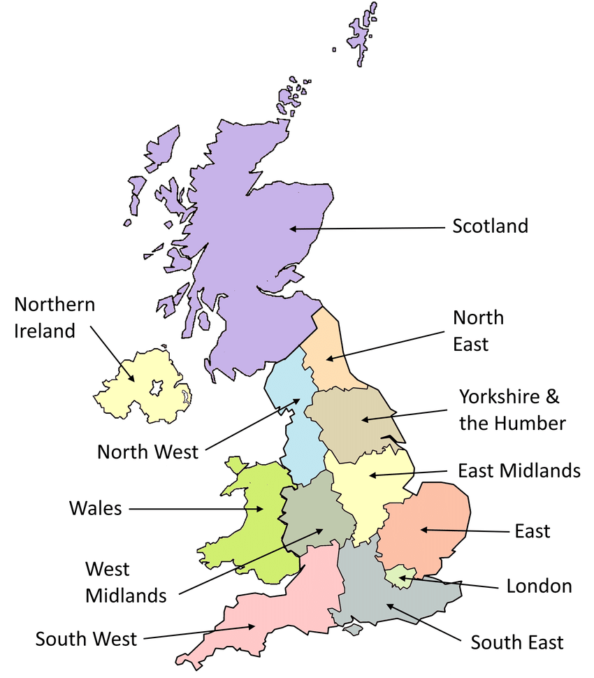
Scotland
Jacquie Nicholson
(Open Univ) &
Andrew Crosbie
(Scottish Qualifications Authority)
England: North East
vacancy
England: Yorks & the Humber
Richard & Ruth Knight
(York St John Univ)
Northern Ireland
Angela Getty
(Ulster Univ)
England: East Midlands
Emma Nadin
(Loughborough Univ)
Wales
vacancy
England: East of England
vacancy
England: North West
Lykara Ryder & Mona Patel
(Manchester Met Univ)
London
Ashok Jashapara
(Royal Holloway, Univ London)
England: West Midlands
Shaukat Ali
(Univ Wolverhampton)
England: South East
Yota Dimitriadi
(Univ Reading) &
Melanie Thorley
(Univ Greenwich)
England: South West
Kelly Pickard-Smith
https://www.researchgate.net/figure/Map-of-NUTS-1-regions-in-the-UK-3_fig1_328861101

Slide 8
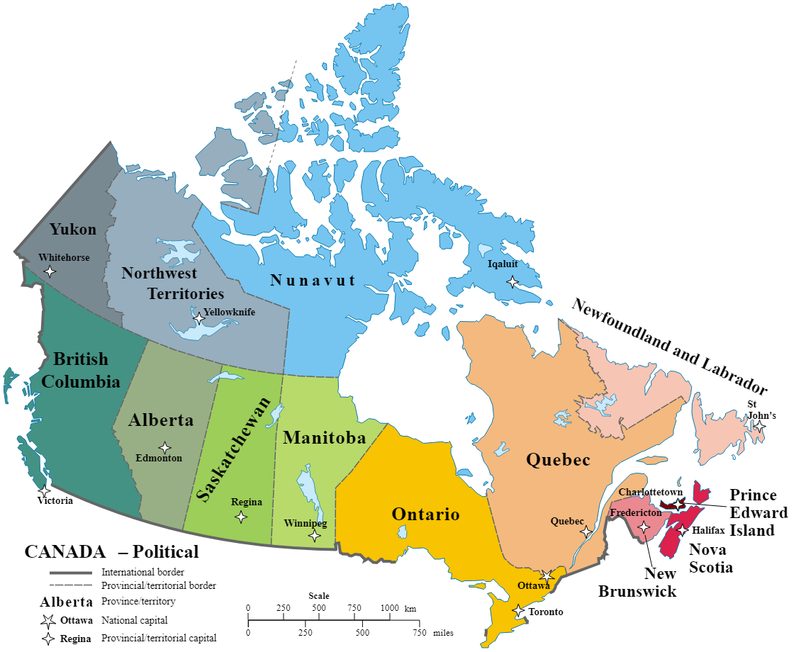
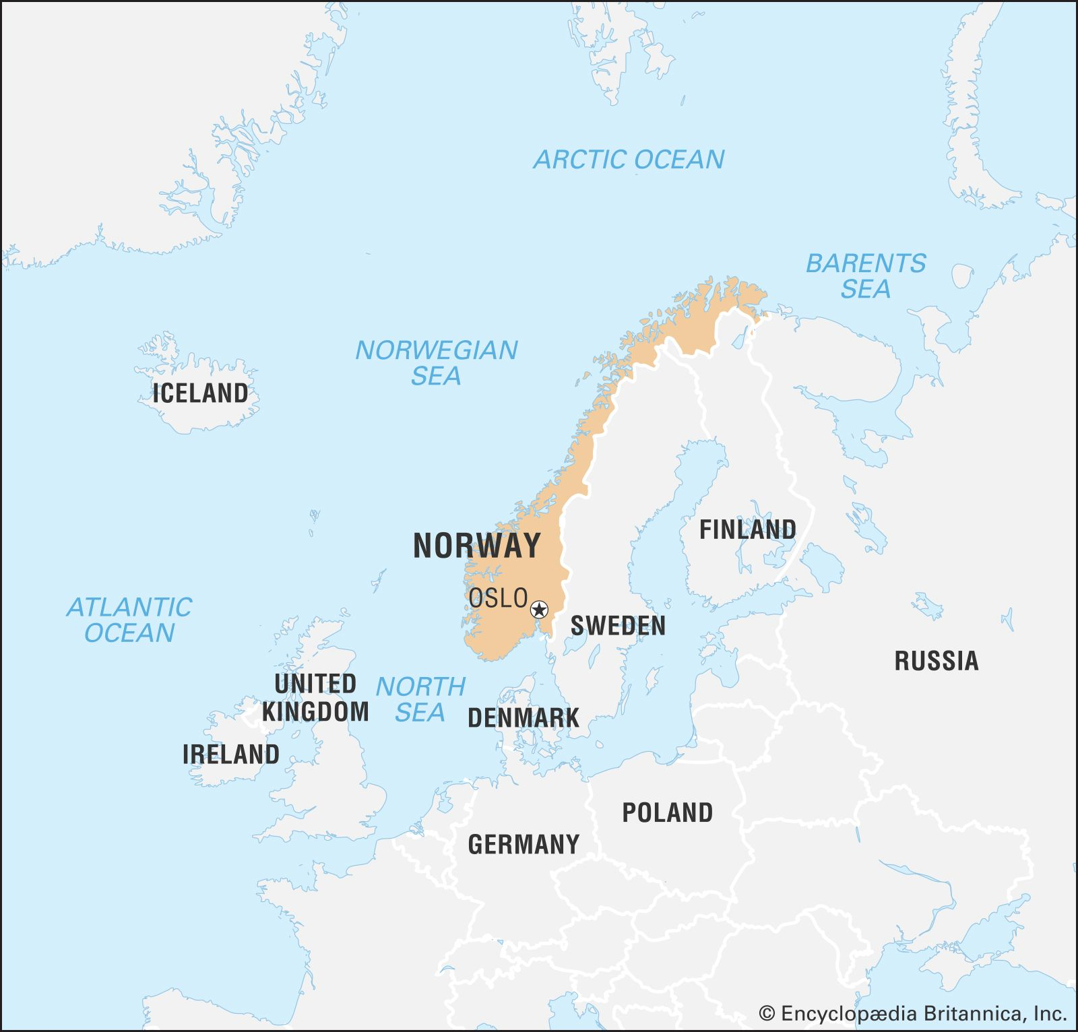
GLOBAL DOMINATION!
Canada & N America
Nancy Hansen
(Univ of Manitoba)
Norway
France Rose Hartline
(NTNU)

Slide 9
SUBGROUPS
STEMM Action Group
Disabled Women in Academia Network
Yota Dimitriadi, et al
(Univ of Reading)
Meredith Wilkinson
(De Montford Univ)
Blind & Visually Impaired Staff & PGRs in Academia Network
Neurodivergence Focus Group
Stuart Gore & Sam Hitchmough
(Univ of Leeds, Univ of Bristol)
Andrew Crosbie
(SQA)
RIDE Higher Project
Melanie Best
(Univ Wolverhampton)

Slide 10
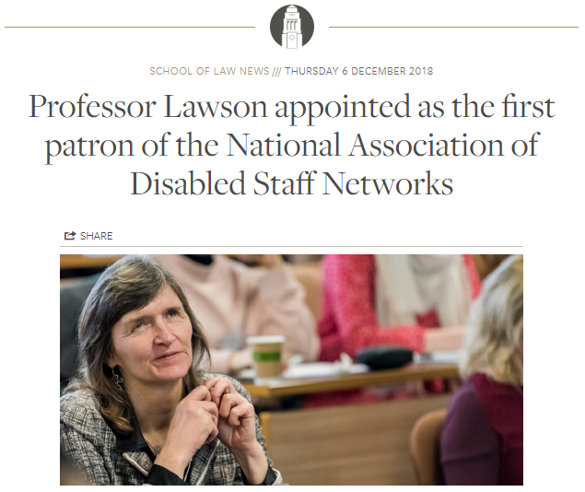
NADSN’s PATRON

Slide 11
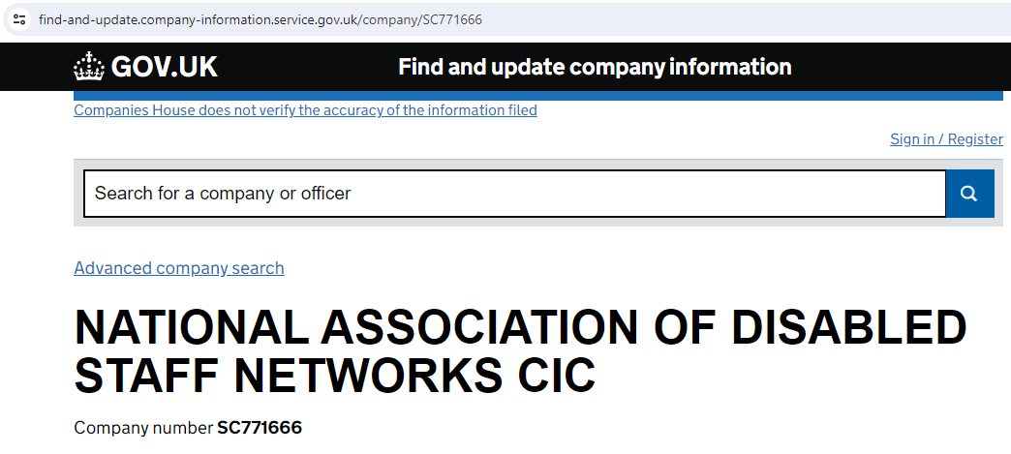

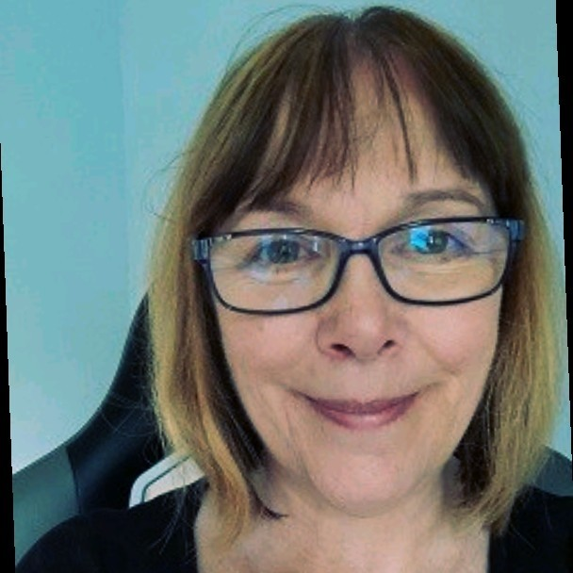
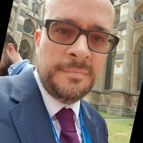
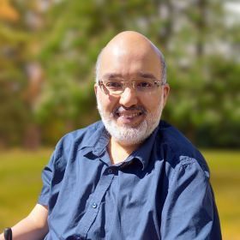
NADSN CIC Directors

Slide 12
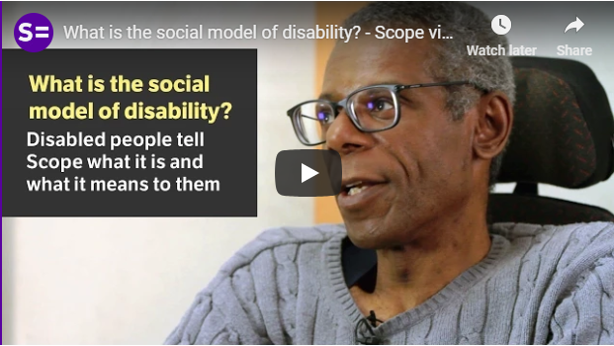
Social Model of Disability
“The social model of disability identifies systemic barriers, negative attitudes and exclusion by society (purposely or inadvertently) that mean society is the main contributory factor in disabling people” (Wikipedia)
Prejudice, ignorance, stigma
Negative attitudes
Inaccessible places, transport, conversations and information
Newer models: to include chronic illness and neurodiversity

Slide 13


UN Convention on the Rights of Persons with Disabilities (CRPD)
Preamble of the CRPD:
“. . . disability is an evolving concept and that disability results from the interaction between persons with impairments and attitudinal and environmental barriers that hinders their full and effective participation in society on an equal basis with others.”

Slide 14
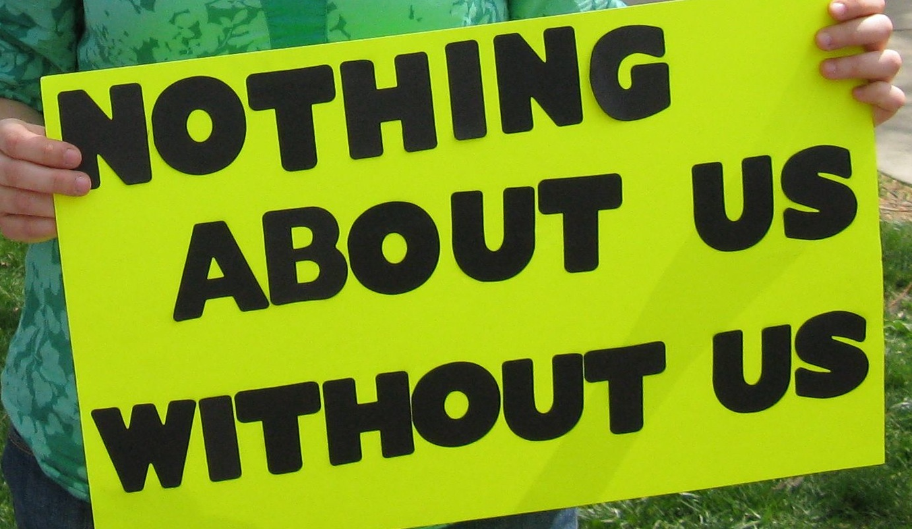

Slide 15



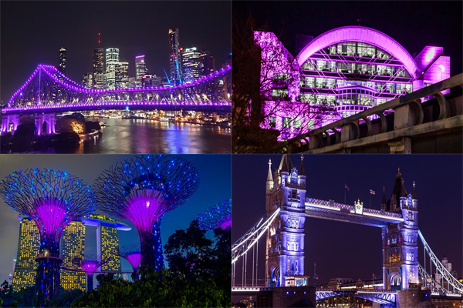

Disability Pride Month | July
14 Nov – 20 Dec
International Day of Disabled People | 3 Dec
Notes:
This black triangle is worn by the men in the photo above – sewn to the left side of their shirts. Disabled people were forced to wear this symbol by the Nazis during the ‘T4′ Eugenics Programme; which was intended to eliminate them. Between 250,000–1 million were murdered by the Nazis’ false hopes of building a ‘master race’.
The UKDHM Logo has taken this symbol, and in reclaiming our history we have inverted it.

Slide 16
NADSN Conference 2024 Programme
Time | Session
10:00-10:10 | Hello, Housekeeping & Wellbeing Dr Melanie Thorley
10:10-10:30 | Welcome & Conference Opening Alan Dudley & Dr Hamied Haroon
10:30-11:00 | Is there Equity in EDI in HE and the Public Sector? Banji Adewumi MBE
11:00-11:15 | MORNING BREAK
11:15-11:45 | The RIDE Higher Framework Dr Melanie Best
11:45-12:15 | NADSN Sub-Groups Showcase Dr Stuart Gore Dr Meredith Wilkinson Andrew Crosbie Prof Yota Dimitriadi & Dr Jennifer Leigh | Blind and Visually Impaired Staff & PGRs in Academia Network Disabled Women in Academia Network Neurodivergence Focus Group STEMM Action Group
12:15-13:30 | LUNCH

Slide 17
NADSN Conference 2024 Programme
Time | Session
12:30-13:15 | Creative Workshop Dr Jennifer Leigh: in-person Andrew Crosbie: online | STAART ART Prize Competition Dr Melanie Thorley
13:30-14:00 | Disability Matters & Wellcome Anti-Ableist Research Culture projects Prof Dan Goodley
14:00-14:45 | Ableism across Time-zones: NADSN going Global! Prof Gayle Brewer (UK), Prof Nancy Hansen (Canada) & Dr France Rose Hartline (Norway)
14:45-15:00 | Documentary Screening: “Marginalisation in Science: Disability & Inclusion” Dr Jennifer Leigh
15:00-15:15 | AFTERNOON BREAK
15:15-15:30 | Greenwich Leading from the Helm Prof Jane Harrington
15:30-16:15 | Celebrating NADSN followed by Reflections, Votes of Thanks & Conference Close Jacquie Nicholson, Stuart Moore & Dr Hamied Haroon
16:15-18:00 | CONFERENCE RECEPTION | STAART ART Prize Competition (continued) Dr Melanie Thorley

Slide 18



A Decade of Community:
Celebrating 10 Years of Empowerment

