Slide 1
A Decade of Community:
Celebrating 10 Years of Empowerment

Slide 2
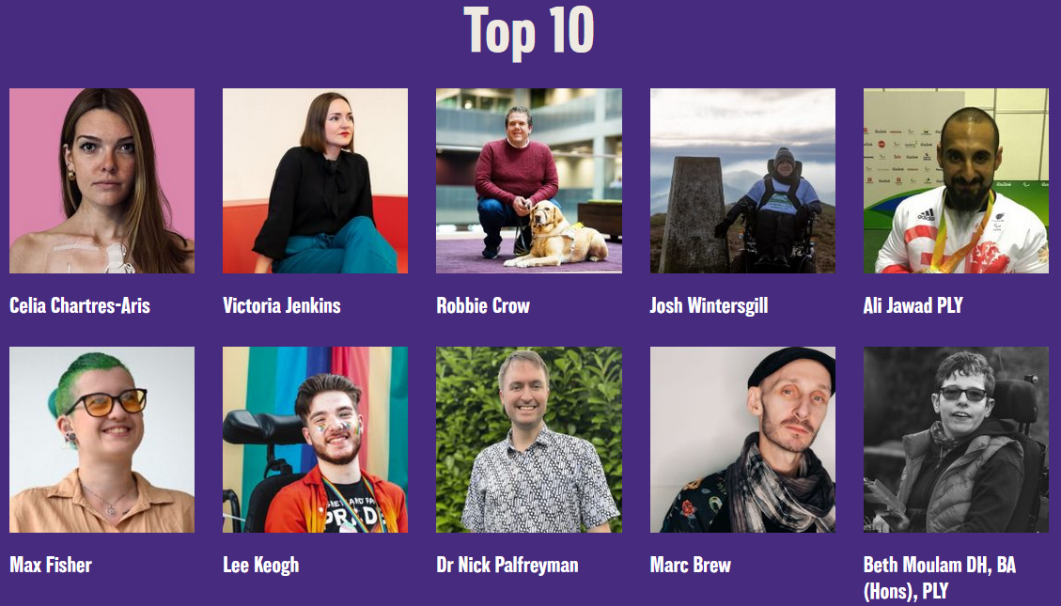

Slide 3
AWARDS
Disabled Staff Network Lead Award.
Intersectionality Award.
Senior Manager / EDI Lead / Executive Champion Award.
International Award.
Most Entertaining Award.
Most Loved Network Mascot or Cuddly Toy Award.
Outstanding Contribution Award.
Unsung Hero Award.

Slide 4
AWARDS

Slide 5
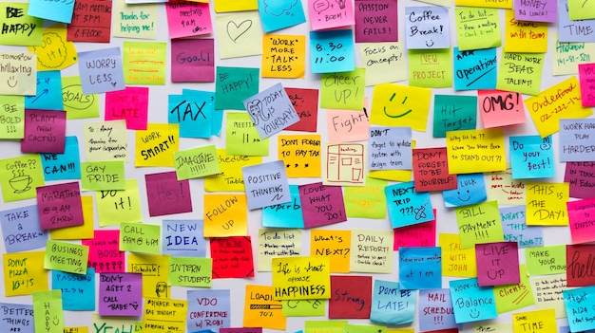
What do you think?
How should we recognise and celebrate our wonderful Networks and colleagues?

