Slide 1
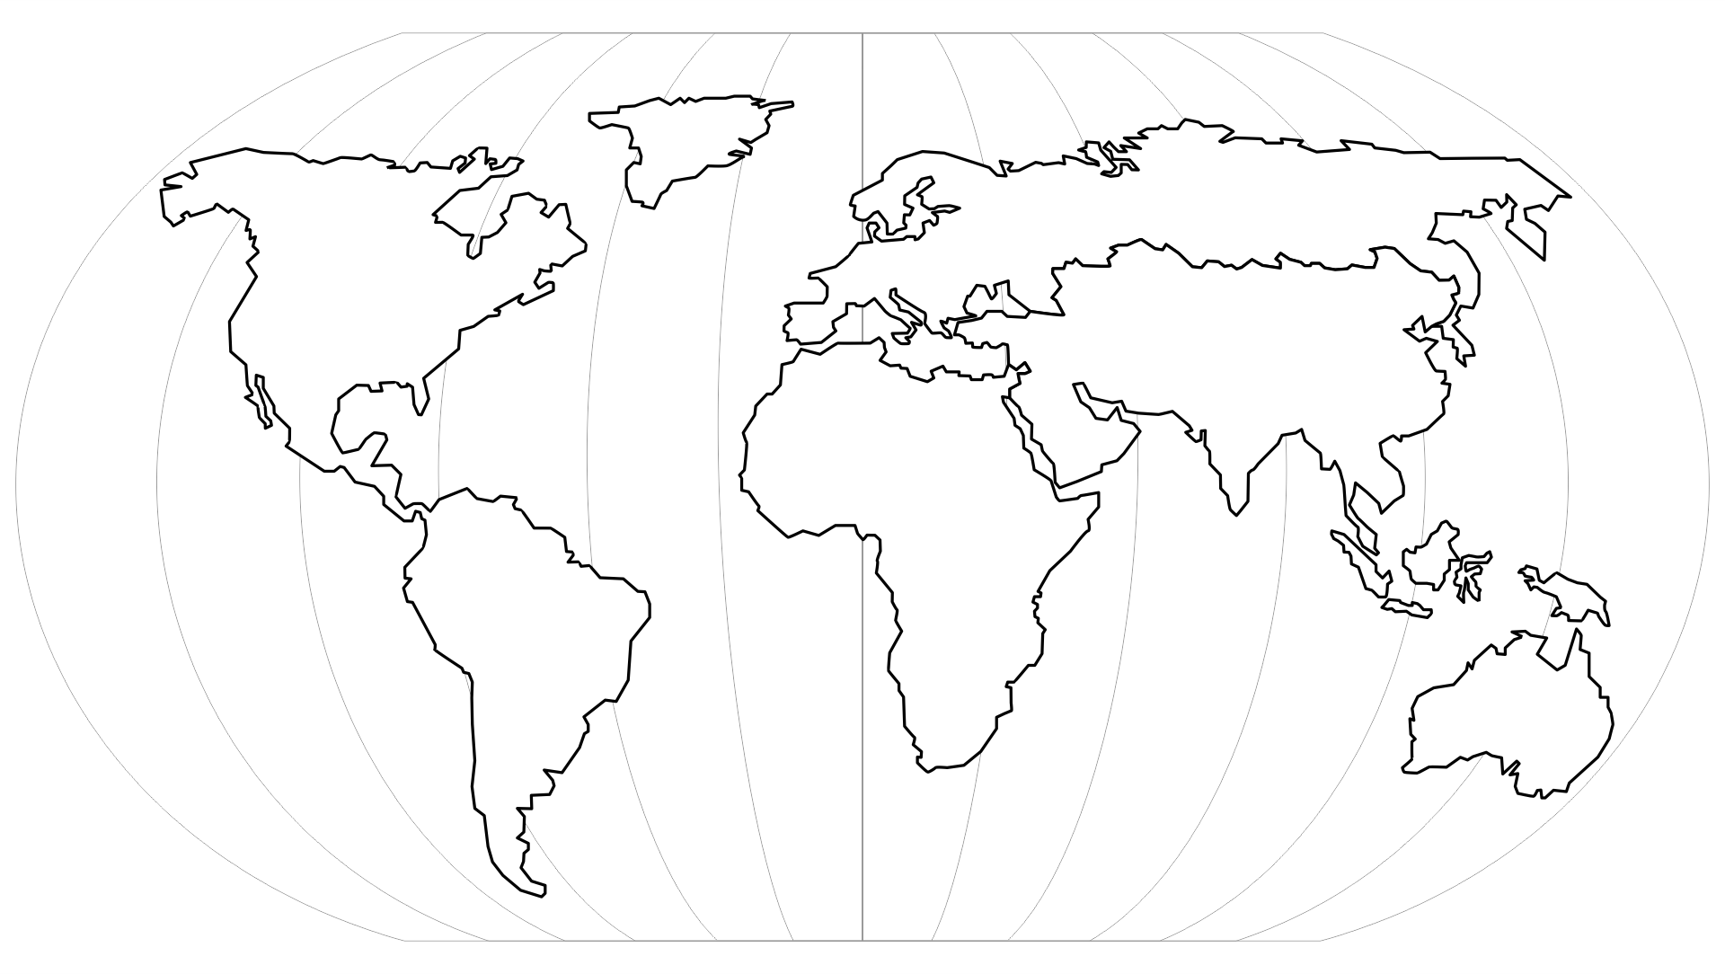
Ableism Across Time Zones: NADSN Going Global!
Gayle Brewer, France Rose Hartline, Nancy Hansen

Slide 2
A Global Approach
Disability is a social justice issue, not a regional one
Significant global activity including,
European Disability Forum
Global Disability Summit
International Disability Alliance
The Global Action on Disability (GLAD) Network
Reports,
WHO, Global Report on Health Equity for Persons with Disabilities
Business Disability Forum, Disability Inclusion in a Changing World

Slide 3
A Global NADSN Approach
Shared NADSN values and purpose
Support
Guidance
Advocacy
Opportunities to share knowledge and experience
Opportunities to increase our reach, recognition, and impact
Digital innovation

Slide 4
Example

Slide 5
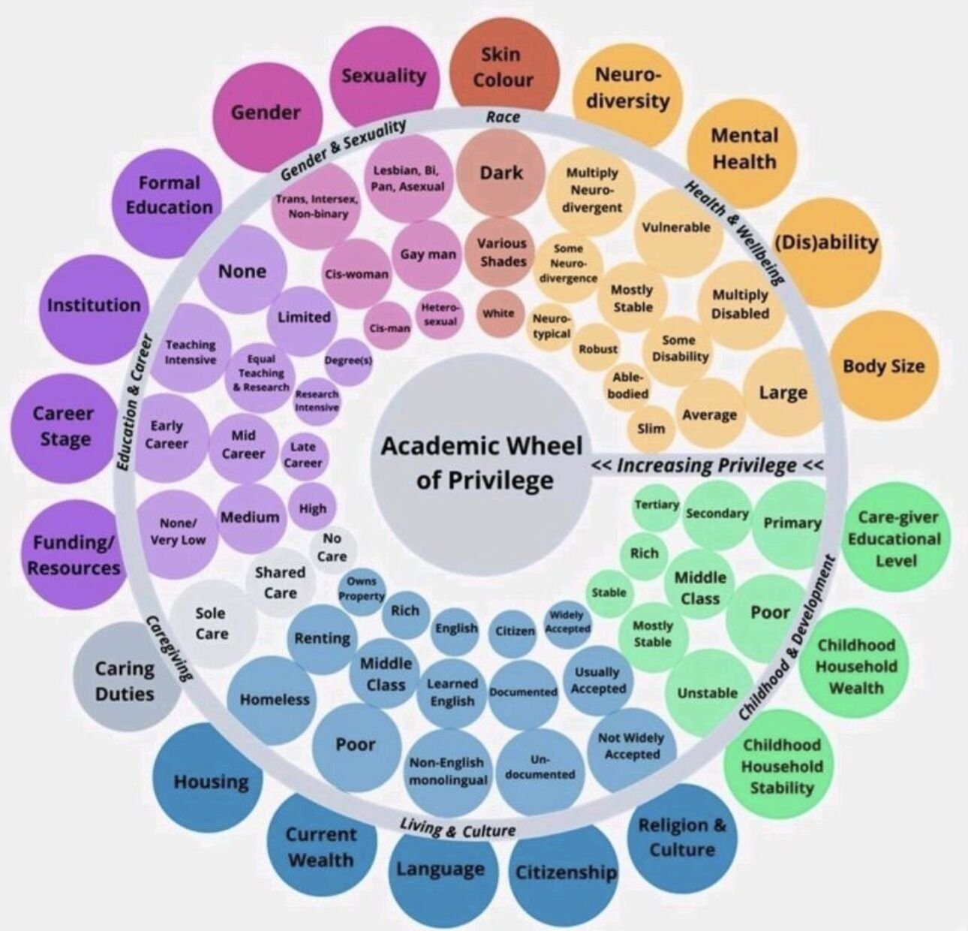
To Consider
Significant variation (education and healthcare funding etc)
Inclusion of ‘non-WEIRD’ countries
Recognising privilege whilst acknowledging limited resources etc
‘N’ADSN and the national / global focus

